Slide 1




NEXT GEN EMPLOYABILITY PROGRAM
Creating a future-ready workforce
Team Members
College Name
Student Name : R.Karthika Devi
Student ID : au951221104017
JP College Of Engineering

Slide 2

CAPSTONE PROJECT SHOWCASE
Project Title
Voting Web Application using Django Framework
Abstract | Problem Statement | Project Overview | Proposed Solution | Technology Used | Modelling & Results | Conclusion

Slide 3
Abstract
This project aims to develop a web-based voting application using the Django framework, a high-level Python web framework known for its simplicity and robustness. The application will provide a user-friendly interface for voters to cast their votes securely and for administrators to manage the voting process The key features of the voting application will include user authentication and authorization, a dynamic and intuitive user interface for voting, real-time result updates, and secure data storage. The application will be designed to handle a large number of users and votes while ensuring the integrity and confidentiality of the voting process Overall, this project aims to demonstrate how the Django framework can be used to develop a secure, scalable, and user-friendly voting application that can be used in various voting scenarios, from elections to surveys and polls
Source :

Slide 4
Problem Statement
Develop a secure and user-friendly web application using Django framework that allows registered users to participate in various voting processes, such as polls, surveys, or elections.
The application should ensure the integrity of votes, provide an intuitive interface for both administrators and users, and include features for authentication, authorization, and result visualization.
Source :

Slide 5
Project Overview
Create a new Django app within the project to handle the voting functionality. This app will contain models, views, templates, and any other necessary components.Define Django models to represent the data associated with the voting system, such as User, Poll, Choice, and Vote.
Project setup
App creation
Database models
Admin interfaces
User authentication
Poll creation
Voting and results display
Frondend design and URL routing
Testing and deployment

Slide 6
Proposed Solution
.
Utilize Django's built-in authentication system for user registration, login, and logout functionalities.
Customize authentication views and templates as needed.
Implement views and templates for displaying candidates and allowing users to cast their votes.
Ensure that each user can only vote once and handle any potential errors or edge cases.
Register models with Django's admin interface to allow administrators to manage candidates, voters, and votes easily.
Customize admin views and templates for better usability if necessary.
Source :

Slide 7
Advantages: 1. Rapid Development:jango’s high-level Python web framework allows for quick development of web applications, including voting systems, due to its built-in features like authentication, admin interface, and database management. 2. Scalability:Django’s scalability allows the voting application to handle a large number of users and votes efficiently, making it suitable for applications with varying traffic loads. 3. Security:Django provides built-in security features such as protection against SQL injection, cross-site scripting (XSS), cross-site request forgery (CSRF), and clickjacking, e and
Source :

Slide 8
Disadvantages
Complexity: Django’s powerful features and flexibility can lead to complexity, especially for beginners. Developers may need to spend more time learning Django’s concepts and best practices.
Performance: Django is a full-stack framework, which means it includes many features that may not be needed for a simple voting application. This can impact performance, especially if the application is not optimized properly..
Limited Flexibility: While Django is highly customizable, there may be cases where its conventions and opinions on how web applications should be structured limit flexibility or require workarounds for specific requirements
Source :

Slide 9




Technology Used
Front-end
Back-end
Source :

Slide 10
Modelling & Results
In developing a voting application using Django, meticulous attention is directed towards both modeling the underlying data structure and effectively presenting the voting results to users.
Through Django's model system, the application's data architecture is meticulously crafted, typically featuring models like Question and Choice to represent the polls and available choices.
Once users have participated in the voting process, conveying the results to them becomes paramount.
Leveraging Django's templating system, the application dynamically generates HTML templates that vividly present the voting outcomes in an intuitive and visually engaging manner.
Furthermore, the application may utilize charting libraries or custom visualization techniques to elucidate the distribution of votes across different options, offering users valuable insights into the voting process's outcome.
Source :

Slide 11
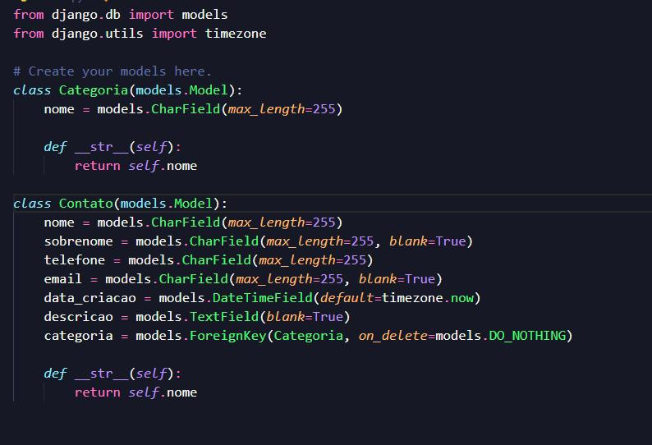
Homepage

Slide 12
About-Us-Page
1.Credibility: The "About Us" page establishes credibility by providing informationabout the organization's history, mission, and team members .
2.Mission and Values: It communicates the organization's mission, values, and objectivesin promoting democratic participation and decision-making.
3. Community Engagement: The page showcases the organization's commitment tocommunity engagement and empowerment through the voting process, inspiring active participation.
4. Contact Information: Users can easily reach out with questions, feedback, or inquiriesabout the voting application through the contact information provided on the page.

Slide 13
Service-Page
Header Section
Introduction section
User Services
Administrator Services
Organizational Services
Technical Services
Consulting Services
Call to Action Services

Slide 14
Departments-Page
Header Section
● Introduction Section
● Department Listings
● Department Details
● Key Personnel
● Collaboration Opportunities
● Footer Section

Slide 15
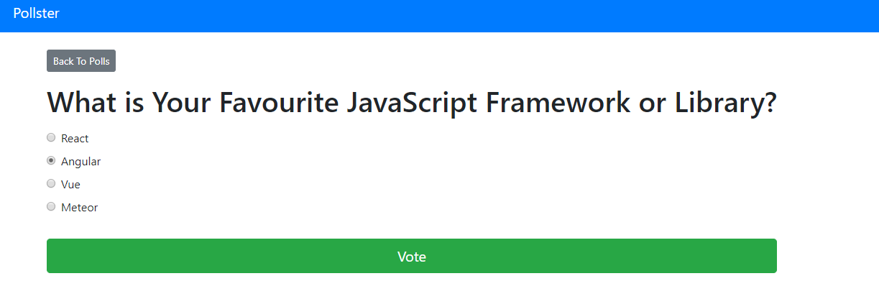
Blog-Page

Slide 16
Future Enhancements:
Utilize machine learning algorithms to analyze voting data, predict future trends, and provide personalized recommendations for users based on their voting history and preferences
Extend the voting application's reach by developing native mobile apps for iOS and Android platforms, offering a seamless and optimized experience for mobile users.
Explore integrating blockchain technology to enhance the transparency, security, and integrity of the voting process, ensuring that votes are immutable and tamper-proof.
Implement comprehensive reporting functionalities for administrators to generate detailed reports on voting patterns, demographics, and trends. This could include visualizations such as charts and graphs.

Slide 17
Conclusion
In conclusion, using Django for a voting web application offers a powerful and feature-rich framework that simplifies development, ensures security, and provides scalability. While there are some potential disadvantages, such as complexity and performance overhead, Django’s advantages, including rapid development, robust security features, and extensive community support, make it a compelling choice for building a voting system. With Django, developers can create a secure, customizable, and scalable voting web application that meets the specific requirements of their project.
Source :

Slide 18
Thank You!
Notes:
Thank You !!

